Slide 1
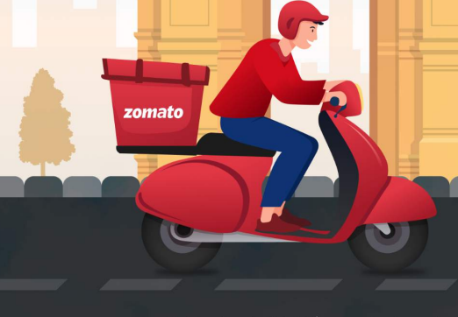
ZOMATO EXPANSION PROJECT
Presentation By -
Prachi Daspute
Newton School.

Slide 2


Slide 3
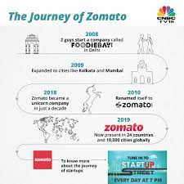
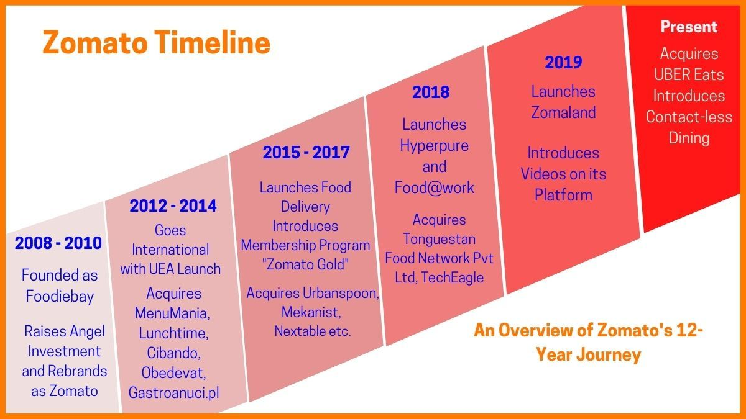
ZOMATO JOURNEY

Slide 4
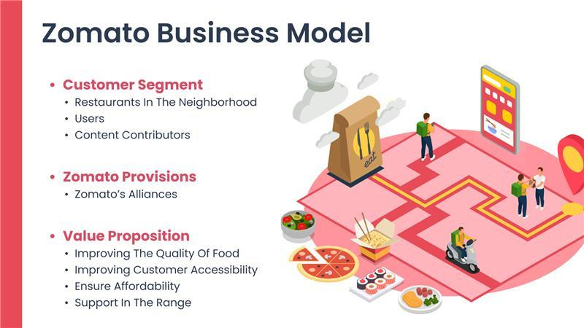

Slide 5
PROBLEM STATEMENT
SUGGESTING SOME COUNTRIES AND CITIES FOR OPENING NEW RESTAURANTS AND EXPANSION STRATEGIES FOR ZOMATO BY ANALYSING THEIR DATASETS.

Slide 6
Contents
Overview
Countries & Cities
for Expansion
Current Scenario
01
02
03
Food Expenditure
04
05
Competition
06
Cuisines
Additional Facilities
Main Findings
07
08
09
Conclusion

Slide 7
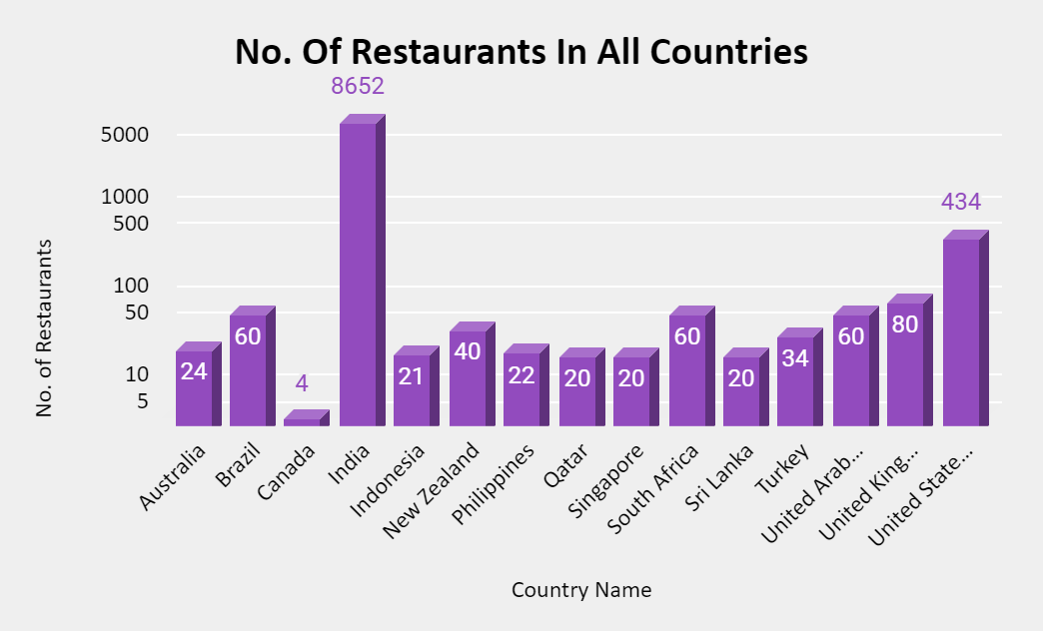
Global Overview

Slide 8
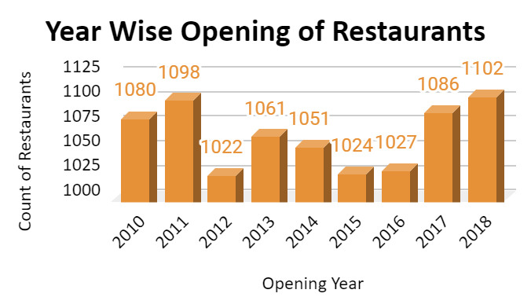
Market Trends
More than 1000 restaurants opened each year.

Slide 9
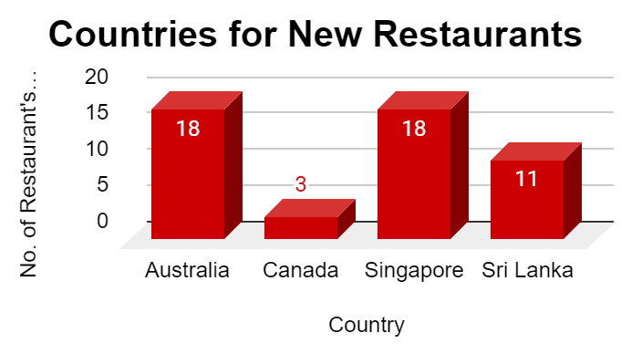
Expansion Opportunities

Slide 10
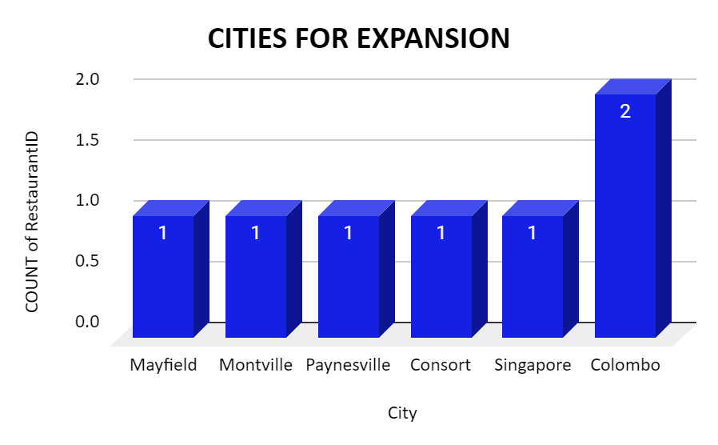

Slide 11
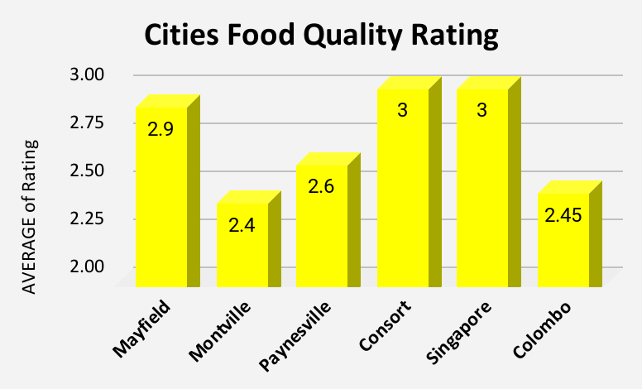
Current Scenario

Slide 12
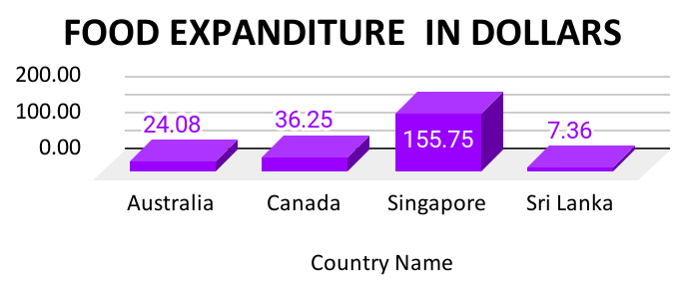
We must have a balanced expenditure on food.

Slide 13
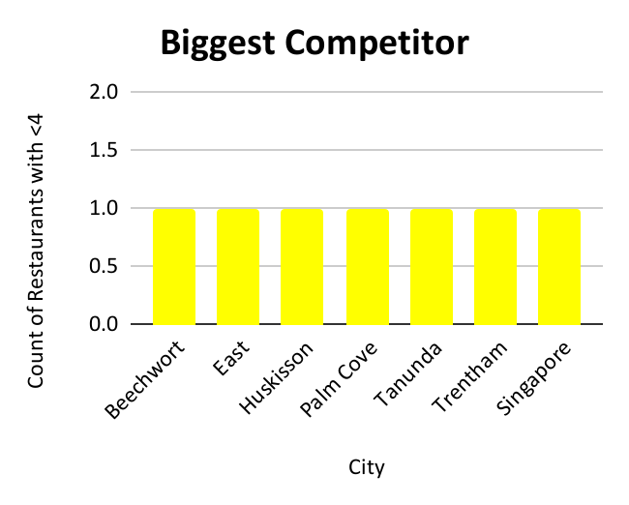
Competition

Slide 14
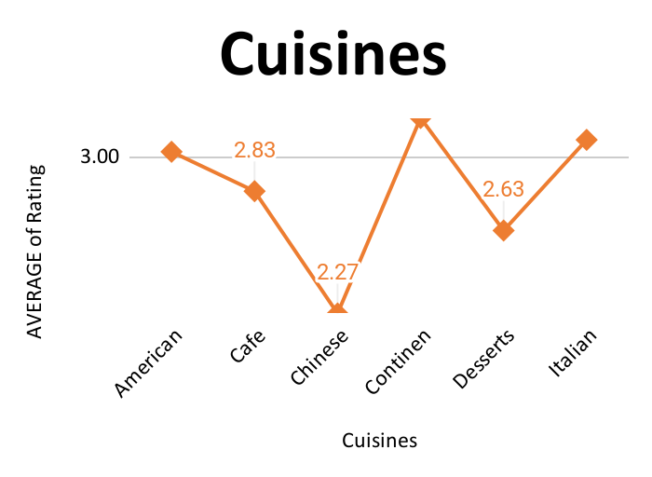
Cuisines
Choice of Cuisines affects the restaurant ratings.

Slide 15
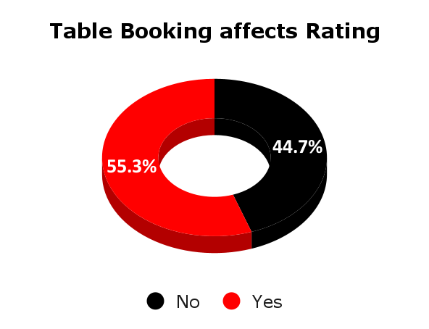
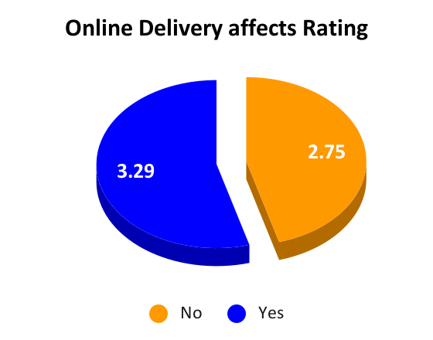
Online Table Booking
Home Delivery
These Additional Facilities affects customer’s ratings.

Slide 16
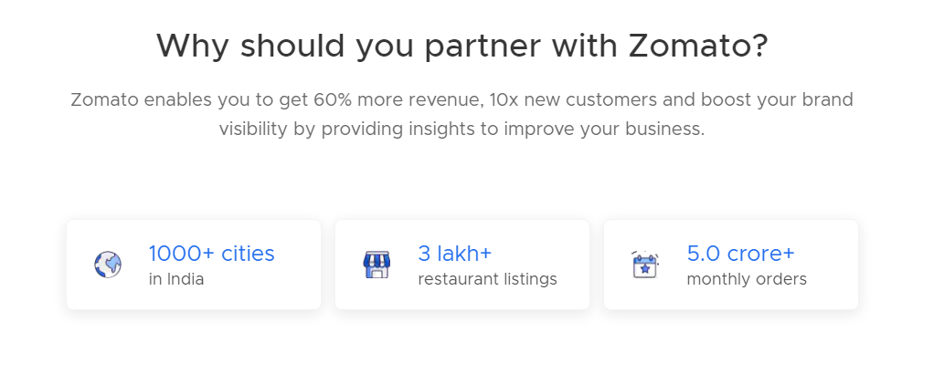
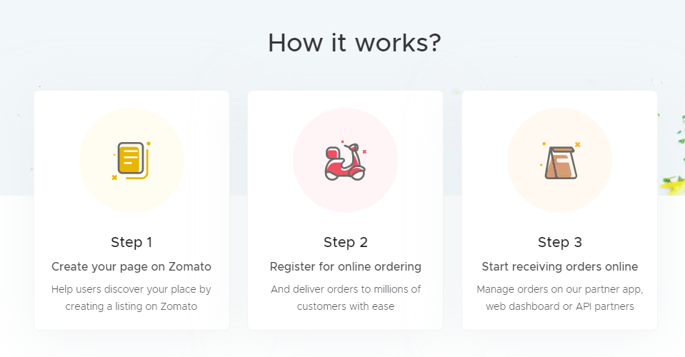
We can offer the current high rating Restaurants to tie up with us.

Slide 17
Conclusion
Top 4 selected countries for our expansion are Australia, Canada, Singapore, Sri Lanka. Our Major Focus will be on Australia, As this Country has 3 most suitable cities.
According to our data, To get a higher rating, We must keep the rate of cuisines in the middle range, keep high quality cuisines and provide additional facilities in our new Restaurants.
We must offer more services like online delivery and table booking to increase the customer’s ratings because customers enjoy additional ease & convenience in their dining experience.

Slide 18
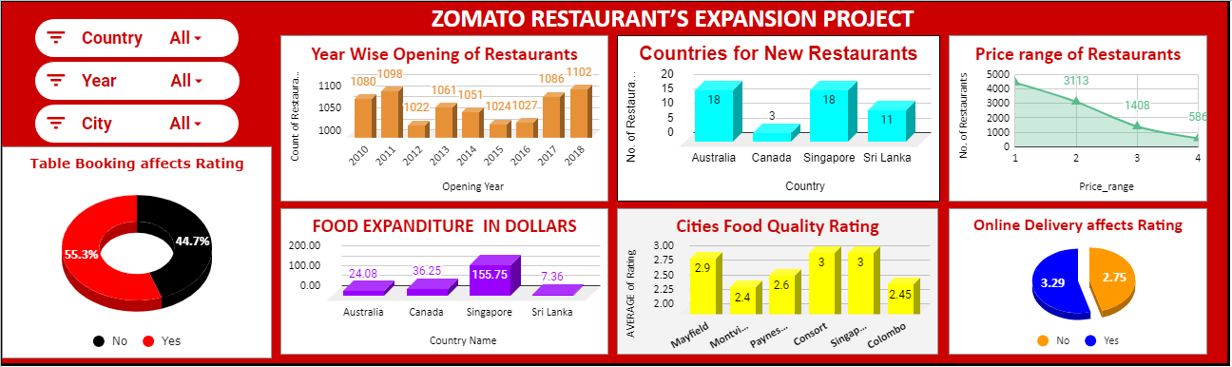
Dashboard

Slide 19
Thank You
Do you have any questions?
prachi.daspute15@gmail..com
my.newtonschool.co

